Slide 1
Breaking the conflict cycle: Escalation and De-escalation on the Korean Peninsula
Dr. Warren Haffar
Dean of International Affairs
Associate Professor of International Peace & Conflict Resolution
Arcadia University

Slide 2
Presentation Topics
Overview of Peace and Conflict Resolution
Conflict Analysis
    Relative Deprivation
  Case study examples
    Northern Ireland
    Cuba
    Iran
    Cyprus
Implications for Conflict Resolution
    Engagement
Implications for North and South Korea

Slide 3
Conflict Resolution:
The Search for Common Ground
One of the central skills in the field of peace and conflict resolution is problem solving:
  Of finding the common ground that exists between people or groups.
Peace and conflict resolution is a broad umbrella that spans conflict in a variety of settings: Interpersonal, community and international.

Slide 4

Conflict Resolution
In conflict resolution the objectives are resolution and collaboration not competition. The strategic focus is on analysis, problem-solving.
Conflict is a symptom of the need for change
Conflict itself is not the problem; the problem is destructive conflict.

Slide 5
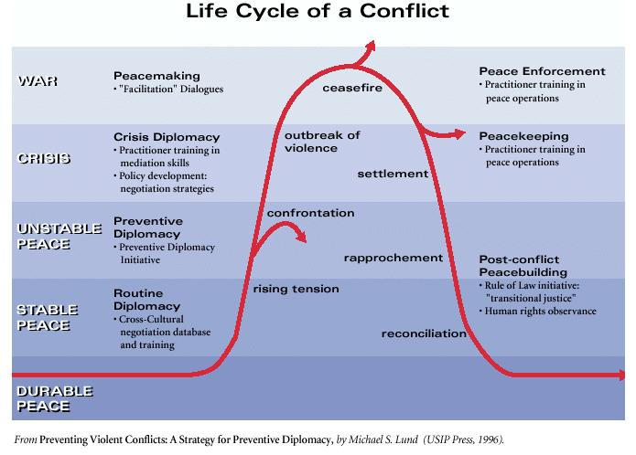
Conflict Cycle

Slide 6
Conflict Analysis
Conflict Analysis: Understanding the causes of conflict:
  Descriptive
Conflict Resolution: Application of methods to resolve or reduce conflict.
  Prescriptive
Conflict Drivers- Elements that create or accelerate conflict between individuals or groups
  Resource scarcity

Slide 7
Relative Deprivation
Deprivation
  “the damaging lack of material benefits considered to be basic necessities in a society.”
  “the lack or denial of something considered to be a necessity.”
Synonyms: poverty, impoverishment, hardship, destitution;

Slide 8
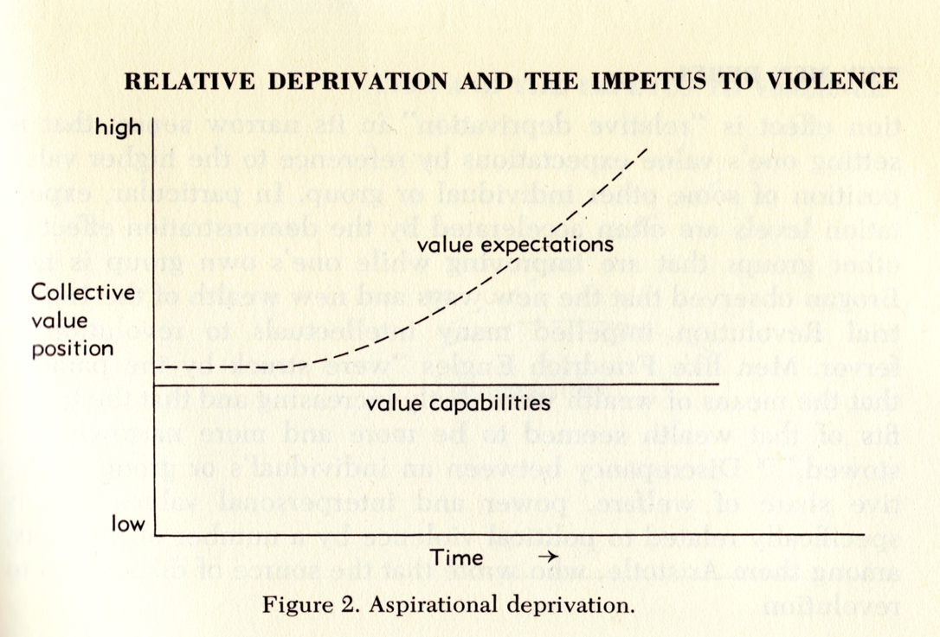
Theories of collective violence: Relative Deprivation

Slide 9
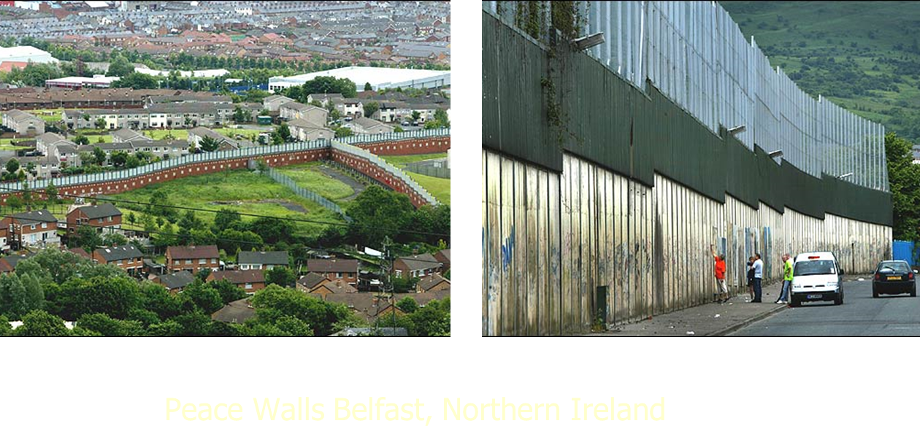
Characteristics of Divided Societies
  Relative Deprivation
  The lines of conflict typically coincide with group identities and where disparities exist, the conflicts have long histories;
  Conflicting parties are in close geographical proximity and there has been direct, physical violence

Slide 10
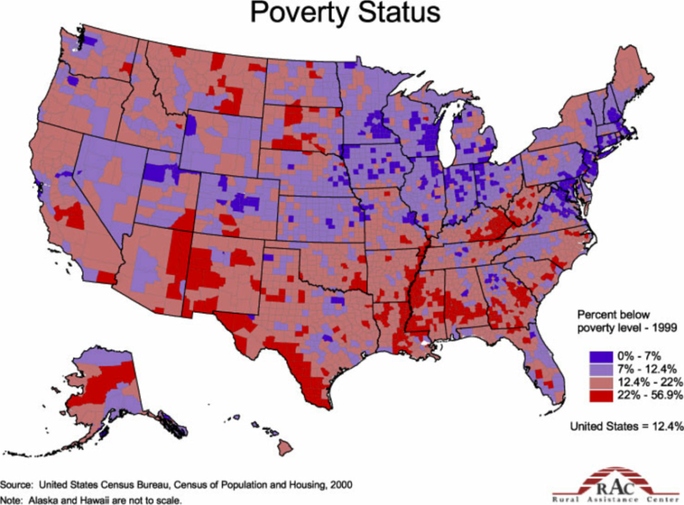
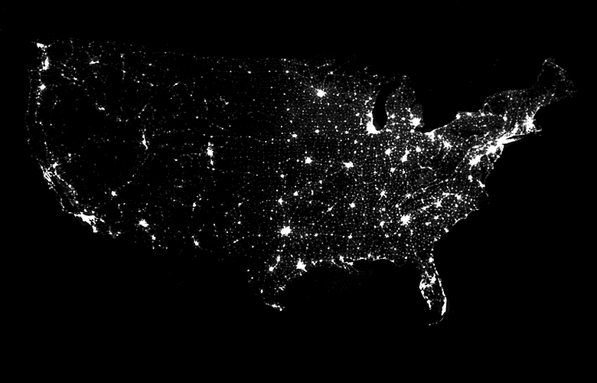
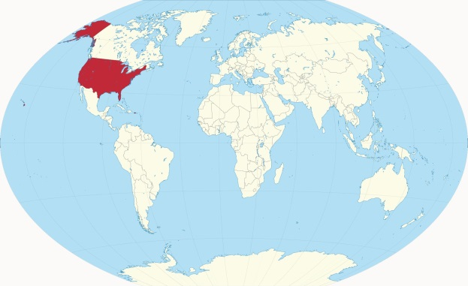
Relative deprivation and the United States

Slide 11
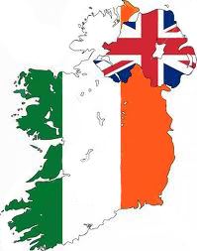
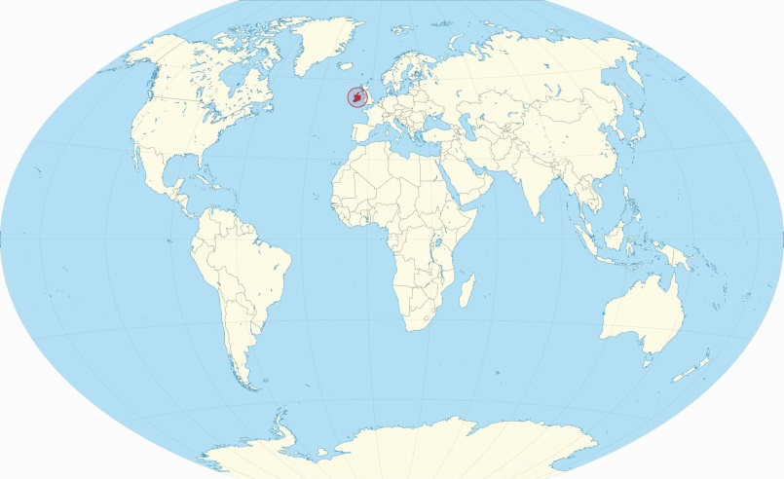
Northern Ireland
The problem:
  Majority of the population of Ireland Catholic and Irish;
  Majority of the population of the north Protestant and British
The Troubles:
  30 year low intensity war
  3,524 people dead; 1,857 civilians
  Violence vs. politics

Slide 12
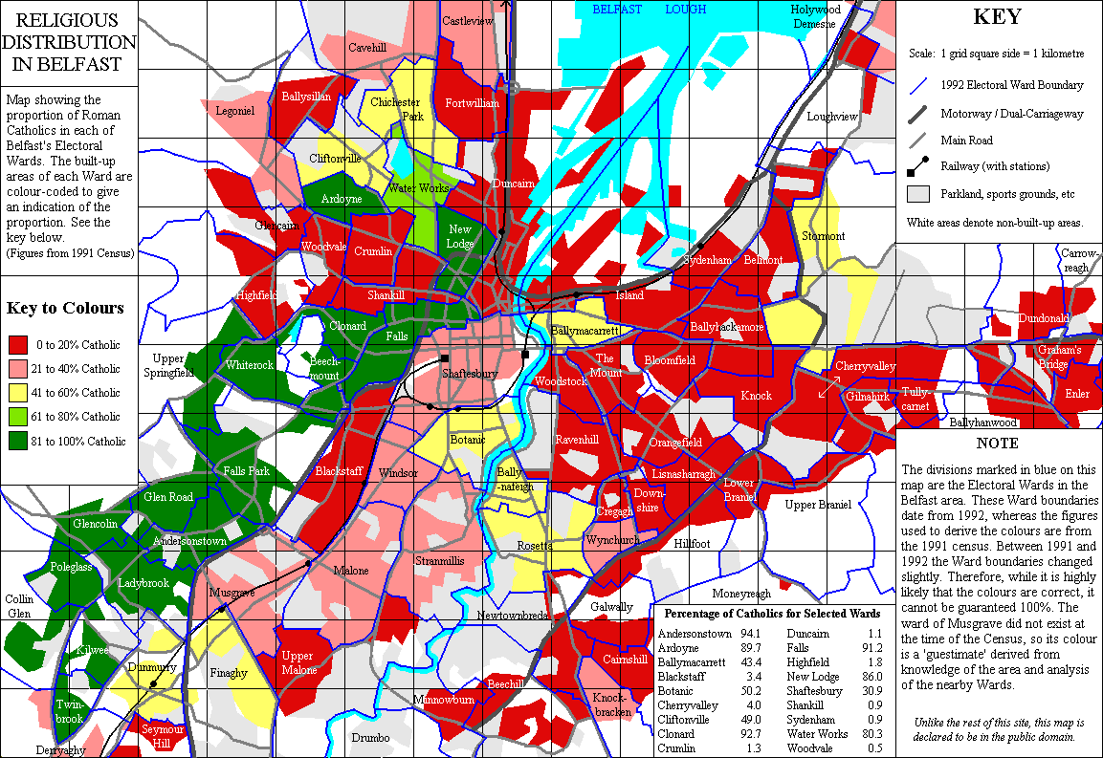
Belfast, Northern Ireland 1991

Slide 13
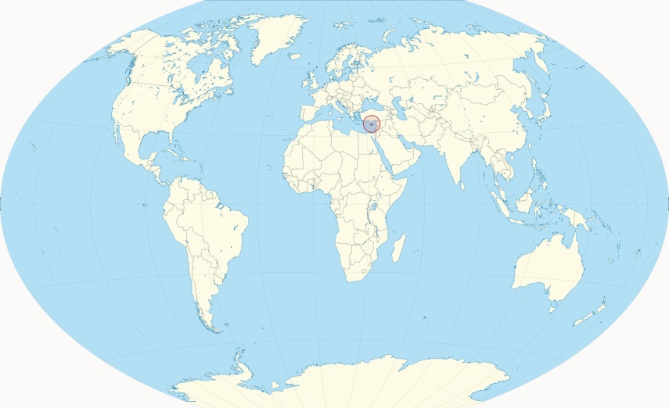
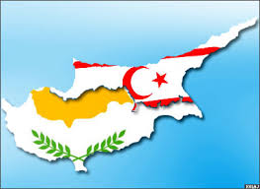
Cyprus
The dispute is an ongoing conflict on the Mediterranean island of Cyprus.
The conflict is between the population of Greek Cypriots and Turkish Cypriots
Since 1974, the United Nations has maintained a buffer zone (the "Green Line”) separating the Greek Cypriot-controlled south from the Turkish Cypriot-controlled north.
Recent years have seen warming of relations between Greek and Turkish Cypriots, with officially renewed diplomatic talks beginning in early 2014.

Slide 14
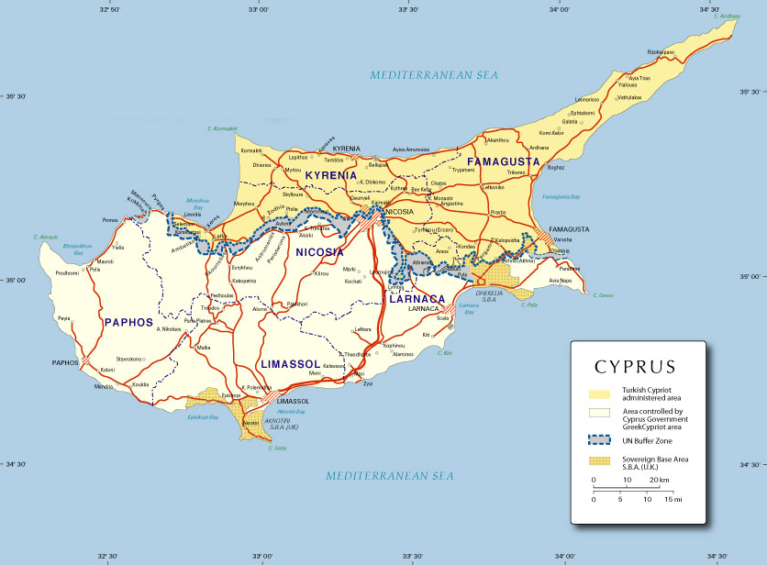
Relative Deprivation: Cyprus

Slide 15
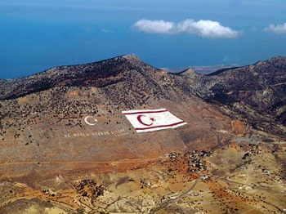
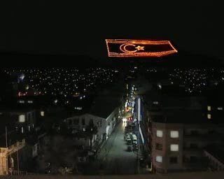
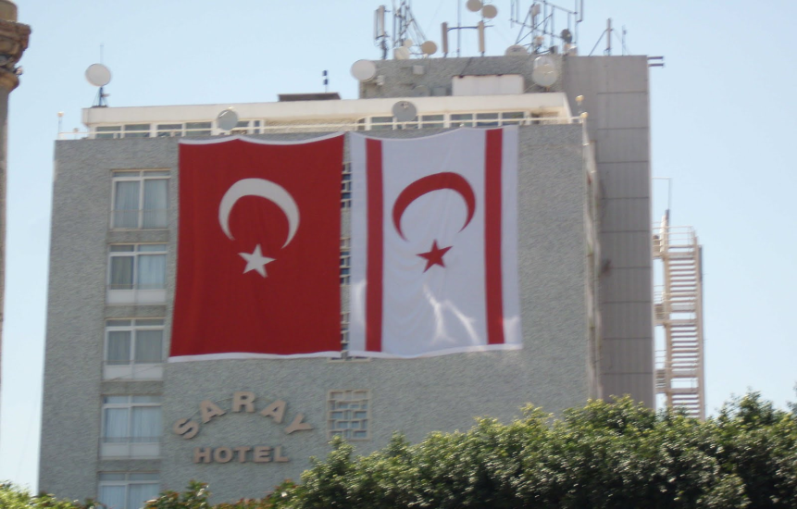
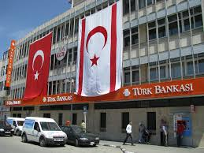
Cyprus

Slide 16

Implications for Conflict Resolution
Great disparities between groups makes conflict more likely
Equality makes conflict less likely
Development through constructive engagement reduces potential threats to peace

Slide 17
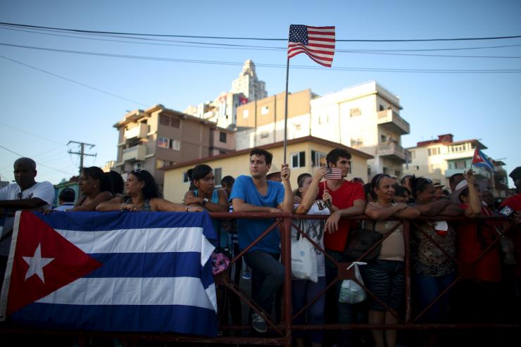
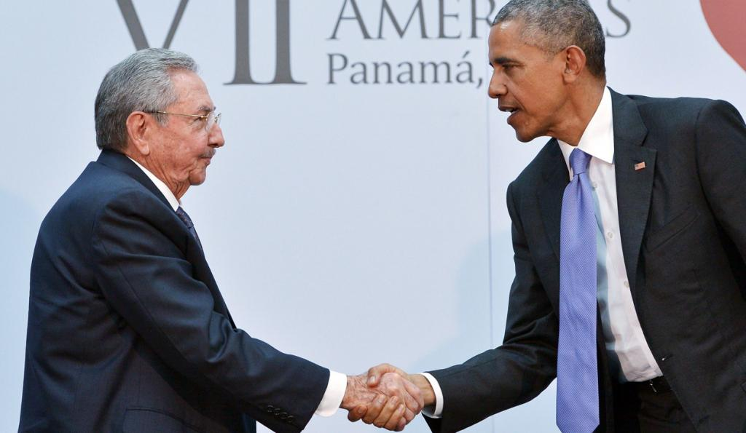

Engagement with Cuba
US and Cuba reach deal to reopen embassies
The United States and Cuba have reached a deal to reopen embassies in Washington and Havana, a US source said Tuesday, in a major step toward ending decades of Cold War enmity.

Slide 18
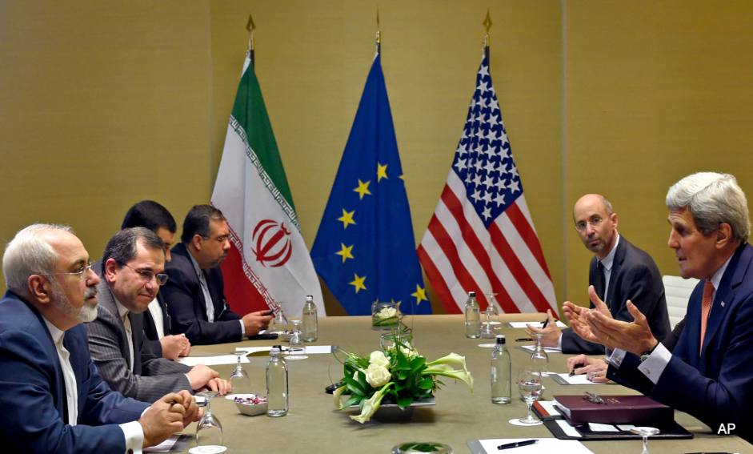
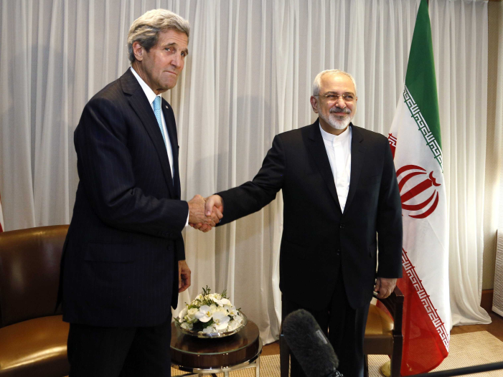
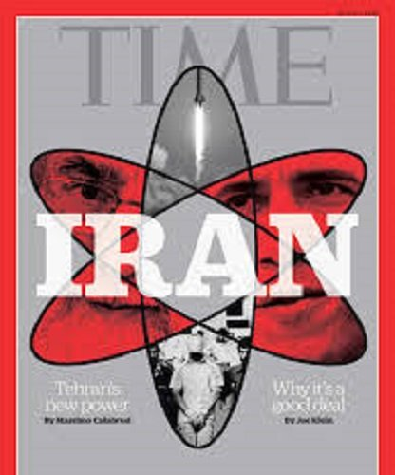
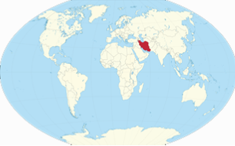
Engagement with Iran

Slide 19
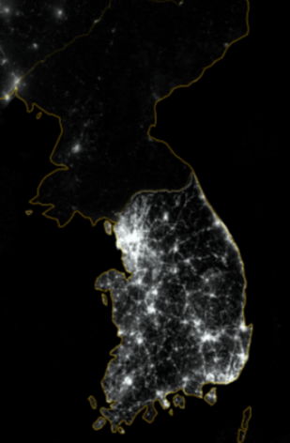

Relative deprivation:
North and South Korea

Slide 20


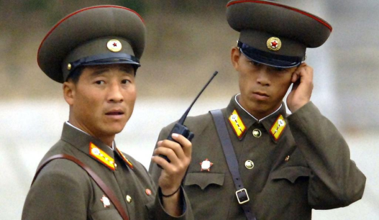
10 Most Censored Countries
    1. Eritrea
    2. North Korea
    3. Saudi Arabia
    4. Ethiopia
    5. Azerbaijan
    6. Vietnam
    7. Iran
    8. China
    9. Myanmar
    10. Cuba
In North Korea, 9.7 percent of the population has cell phones
In South Korea, 85% of the population has cell phones.

Slide 21
Conclusions and Implications for Korean Peace
Engagement as a strategy for conflict resolution works.
Reconciliation is an evolutionary process, slow, but inevitable;
Players are not irrational, but responding to perceived threats in a predictable way;
Systems of cooperation are in place, albeit small and isolated, can be built upon;
Confidence building measures rather than confrontational rhetoric and demonization are the best way to affect changes.

Slide 22
Thank you!

